Slide 1
Greedy Algorithms -II

Slide 2
Huffman Coding

Slide 3
Huffman Coding
Huffman codes can be used to compress information
  Like WinZip – although WinZip doesn’t use the Huffman algorithm
  JPEGs do use Huffman as part of their compression process
The basic idea is that instead of storing each character in a file as an 8-bit ASCII value, we will instead store the more frequently occurring characters using fewer bits and less frequently occurring characters using more bits
  On average this should decrease the filesize (usually ½)

Slide 4
Huffman Coding
As an example, lets take the string:
  “duke blue devils”
We first to a frequency count of the characters:
    e:3, d:2, u:2, l:2, space:2, k:1, b:1, v:1, i:1, s:1
Next we use a Greedy algorithm to build up a Huffman Tree
  We start with nodes for each character
e,3
d,2
u,2
l,2
sp,2
k,1
b,1
v,1
i,1
s,1

Slide 5
Huffman Coding
We then pick the nodes with the smallest frequency and combine them together to form a new node
  The selection of these nodes is the Greedy part
The two selected nodes are removed from the set, but replace by the combined node
This continues until we have only 1 node left in the set

Slide 6
Huffman Coding
e,3
d,2
u,2
l,2
sp,2
k,1
b,1
v,1
i,1
s,1

Slide 7
Huffman Coding
e,3
d,2
u,2
l,2
sp,2
k,1
b,1
v,1
2
i,1
s,1

Slide 8
Huffman Coding
e,3
d,2
u,2
l,2
sp,2
k,1
2
2
b,1
v,1
i,1
s,1

Slide 9
Huffman Coding
e,3
d,2
u,2
l,2
sp,2
3
2
k,1
2
i,1
s,1
b,1
v,1

Slide 10
Huffman Coding
e,3
d,2
u,2
4
3
2
l,2
sp,2
k,1
2
i,1
s,1
b,1
v,1

Slide 11
Huffman Coding
e,3
4
4
3
2
d,2
u,2
l,2
sp,2
k,1
2
i,1
s,1
b,1
v,1

Slide 12
Huffman Coding
e,3
4
4
5
d,2
u,2
l,2
sp,2
2
3
i,1
s,1
k,1
2
b,1
v,1

Slide 13
Huffman Coding
7
4
5
e,3
4
l,2
sp,2
2
3
d,2
u,2
i,1
s,1
k,1
2
b,1
v,1

Slide 14
Huffman Coding
7
9
e,3
4
4
5
d,2
u,2
l,2
sp,2
2
3
i,1
s,1
k,1
2
b,1
v,1

Slide 15
Huffman Coding
16
7
9
e,3
4
4
5
d,2
u,2
l,2
sp,2
2
3
i,1
s,1
k,1
2
b,1
v,1

Slide 16
Huffman Coding
Now we assign codes to the tree by placing a 0 on every left branch and a 1 on every right branch
A traversal of the tree from root to leaf give the Huffman code for that particular leaf character
Note that no code is the prefix of another code

Slide 17




Huffman Coding
e | 00
d | 010
u | 011
l | 100
sp | 101
i | 1100
s | 1101
k | 1110
b | 11110
v | 11111
16
7
9
e,3
4
4
5
d,2
u,2
l,2
sp,2
2
3
i,1
s,1
k,1
2
b,1
v,1

Slide 18
Huffman Coding
These codes are then used to encode the string
Thus, “duke blue devils” turns into:
010 011 1110 00 101 11110 100 011 00 101 010 00 11111 1100 100 1101
When grouped into 8-bit bytes:
01001111 10001011 11101000 11001010 10001111 11100100 1101xxxx
Thus it takes 7 bytes of space compared to 16 characters * 1 byte/char = 16 bytes uncompressed

Slide 19
Huffman Coding
Uncompressing works by reading in the file bit by bit
  Start at the root of the tree
  If a 0 is read, head left
  If a 1 is read, head right
  When a leaf is reached decode that character and start over again at the root of the tree
Thus, we need to save Huffman table information as a header in the compressed file
  Doesn’t add a significant amount of size to the file for large files (which are the ones you want to compress anyway)
  Or we could use a fixed universal set of codes/freqencies

Slide 20

Minimise max lateness
Given set S of activities. For each is
a duration ti
A deadline di
Lateness li of an activity is si+ti-di where si is the
start time you schedule it at.
Give the algorithm to order the activities to minimise
Lateness where overall lateness is defined as below where fi=ti+si
If the deadline is after the time you finish then lateness is 0. Else a positive.
46

Slide 21
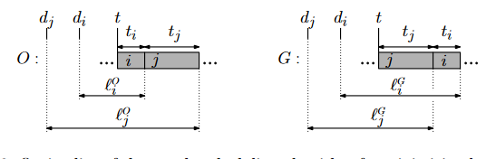

Minimise max lateness
Strategy: Order by earlier deadline
Let the optimal and greedy solution be same until a point.
Let activities ai and aj be the first pair of activities where
dj<di but optimal schedules ai before aj.
47

Slide 22
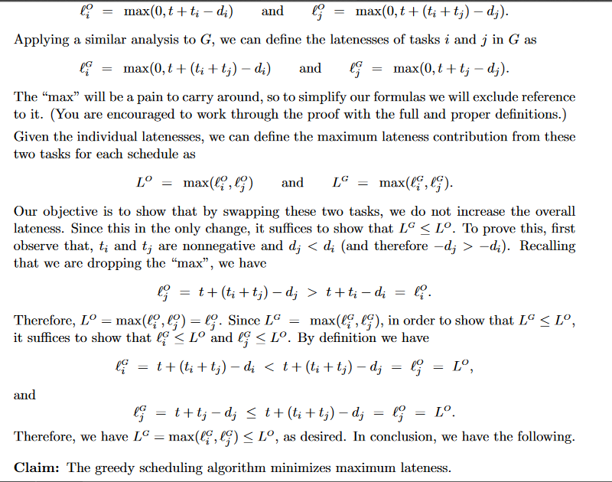
Minimise lateness
48

Slide 23
Minimum spanning tree
A minimum spanning tree is a least-cost subset of the edges of a graph that connects all the nodes
  Start by picking any node and adding it to the tree
  Repeatedly: Pick any least-cost edge from a node in the tree to a node not in the tree, and add the edge and new node to the tree
  Stop when all nodes have been added to the tree
6
The result is a least-cost (3+3+2+2+2=12) spanning tree
If you think some other edge should be in the spanning tree:
  Try adding that edge
  Note that the edge is part of a cycle
  To break the cycle, you must remove the edge with the greatest cost
    This will be the edge you just added
4
2
1
4
5
3
2
3
3
2
3
3
2
4
4
49

Slide 24
Other greedy algorithms
Dijkstra’s algorithm for finding the shortest path in a graph
  Always takes the shortest edge connecting a known node to an unknown node
Kruskal’s algorithm for finding a minimum-cost spanning tree
  Always tries the lowest-cost remaining edge
Prim’s algorithm for finding a minimum-cost spanning tree
  Always takes the lowest-cost edge between nodes in the spanning tree and nodes not yet in the spanning tree
52

Slide 25
Dijkstra’s shortest-path algorithm
Dijkstra’s algorithm finds the shortest paths from a given node to all other nodes in a graph
  Initially,
    Mark the given node as known (path length is zero)
    For each out-edge, set the distance in each neighboring node equal to the cost (length) of the out-edge, and set its predecessor to the initially given node
  Repeatedly (until all nodes are known),
    Find an unknown node containing the smallest distance
    Mark the new node as known
    For each node adjacent to the new node, examine its neighbors to see whether their estimated distance can be reduced (distance to known node plus cost of out-edge)
      If so, also reset the predecessor of the new node
53

Slide 26
Analysis of Dijkstra’s algorithm I
Assume that the average out-degree of a node is some constant k
  Initially,
    Mark the given node as known (path length is zero)
      This takes O(1) (constant) time
    For each out-edge, set the distance in each neighboring node equal to the cost (length) of the out-edge, and set its predecessor to the initially given node
      If each node refers to a list of k adjacent node/edge pairs, this takes O(k) = O(1) time, that is, constant time
      Notice that this operation takes longer if we have to extract a list of names from a hash table
54

Slide 27
Analysis of Dijkstra’s algorithm II
Repeatedly (until all nodes are known), (n times)
  Find an unknown node containing the smallest distance
    Probably the best way to do this is to put the unknown nodes into a priority queue; this takes k * O(log n) time each time a new node is marked “known” (and this happens n times)
  Mark the new node as known -- O(1) time
  For each node adjacent to the new node, examine its neighbors to see whether their estimated distance can be reduced (distance to known node plus cost of out-edge)
    If so, also reset the predecessor of the new node
    There are k adjacent nodes (on average), operation requires constant time at each, therefore O(k) (constant) time
  Combining all the parts, we get:
  O(1) + n*(k*O(log n)+O(k)), that is, O(nk log n) time
55

Slide 28
Connecting wires. HOMEWORK
There are n white dots and n black dots, equally spaced, in a line
You want to connect each white dot with some one black dot, with a minimum total length of “wire”
Example:
Total wire length above is 1 + 1 + 1 + 5 = 8
Join leftmost white to leftmost black. Proof done in class.
56

Slide 29
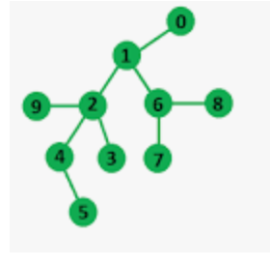
Max independent set in a tree
Given an undirected tree of nodes and connecting edges, find the maximum set of independent vertices such that no two nodes in the output set share an edge.
Consider a linear chain (its a tree as no cycles). Every alternative node will together make an independent set.
0,,6,2,5 is an
independent set
9,5,3,7,8,0,2 is max
independent set
5

Slide 30
Max independent set in a tree
Will there exist an optimal that will contain all leaf nodes ?
5

Slide 31
Max independent set in a tree
Will there exist an optimal that will contain all leaf nodes ?
Give algorithm for max independent set in the tree
Will this work for graph with cycles
5

